Slide 1
生产者-消费者
同步和信号量

Slide 2
Issues
Busy-waiting enforces the order threads access a critical section.
Using mutexes, the order is left to chance and the system.
There are applications where we need to control the order threads access the critical section.

Slide 3
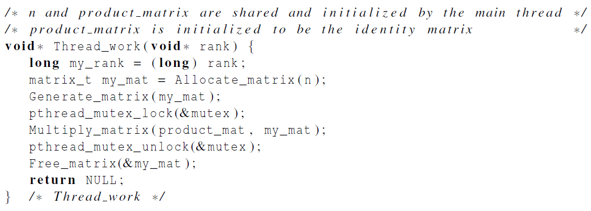
Problems with a mutex solution

Slide 4
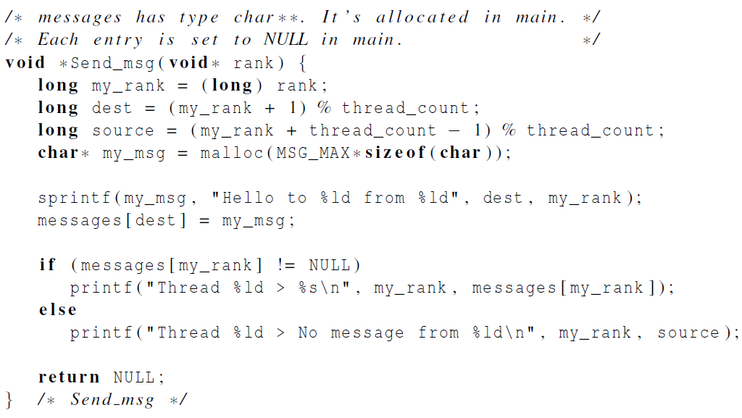
A first attempt at sending messages using pthreads

Slide 5

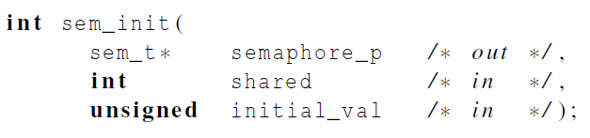
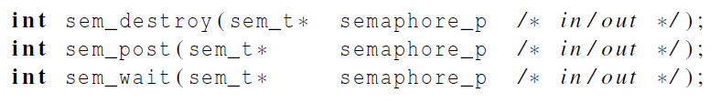
Syntax of the various semaphore functions
Semaphores are not part of Pthreads;
you need to add this.

Slide 6
Barriers实现

Slide 7
Barriers
Synchronizing the threads to make sure that they all are at the same point in a program is called a barrier.
No thread can cross the barrier until all the threads have reached it.

Slide 8
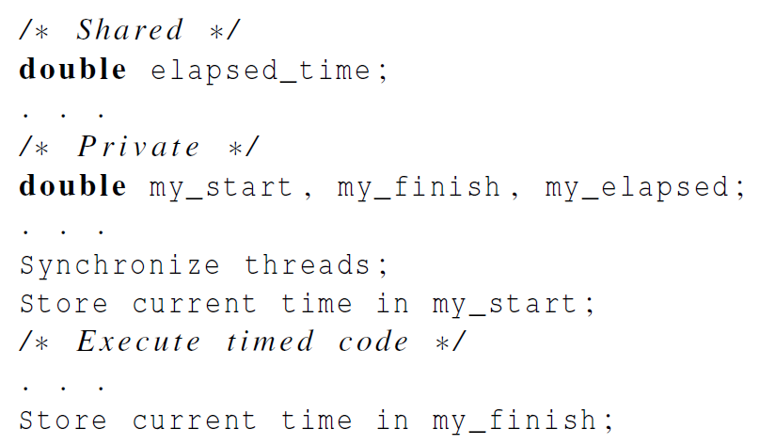
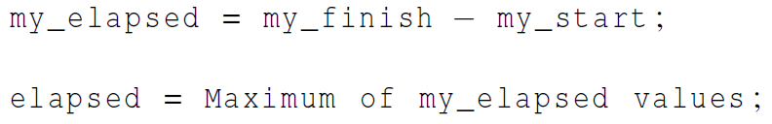
Using barriers to time the slowest thread

Slide 9
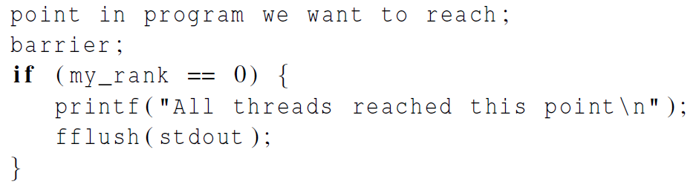
Using barriers for debugging

Slide 10
Busy-waiting and a Mutex
Implementing a barrier using busy-waiting and a mutex is straightforward.
We use a shared counter protected by the mutex.
When the counter indicates that every thread has entered the critical section, threads can leave the critical section.

Slide 11
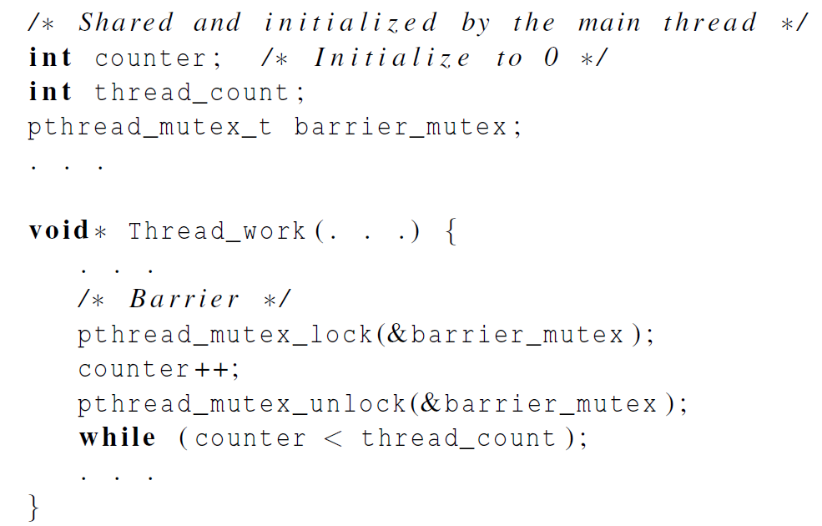
Busy-waiting and a Mutex
We need one counter
variable for each
instance of the barrier,
otherwise problems
are likely to occur.

Slide 12
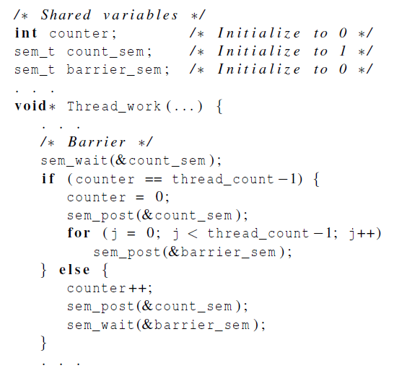
Implementing a barrier with semaphores

